Slide 1

Hacking Android Apps
By Thomas Colligan

Slide 2
Attack Vectors
Attacking the Android Device / OS
Attacking the mobile application
Attacking the mobile application’s backend/web api

Slide 3
Hack Demo Android Application
https://github.com/tcolligan/HackExample

Slide 4
Attacking the Android Device/OS
What is adb?
What is a rooted android device?
shell@t0ltevzw:/ $ vs root@vbox86p:/ #

Slide 5
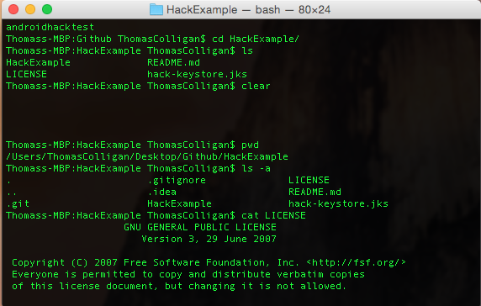
Into Terminal!

Slide 6
Attacking the Mobile Application
Retrieve the app’s apk file
Download from website here
There is an app for that
Pull off of rooted android device with adb
Decompile the apk
There is a website for that
Use open source command line tools, apktool, dex2jar, JAD java descompiler
Android code is compiled: .java -> .class -> .dex
Dexguard and Proguard?

Slide 7
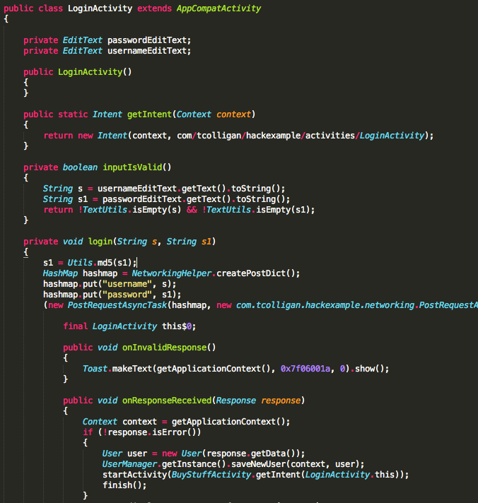
Into the Source Code!

Slide 8
Summary
1. Applications running on rooted devices are much easier to hack into. Extremely difficult to secure applications on rooted devices.
2. Make sure you save all of your application data in the private application sandbox.
3. Be careful with how you structure your DevOptions screens, can be automatically launched on rooted devices.
4. Easy to download an apk and de-compile it, use proguard to obfuscate the code
5. Avoid putting api tokens in your source code, have them on your server behind a login process if possible, base64 can slow hackers down

Slide 9
Summary
6. Always use HTTPS to avoid mitma, be careful with code that accepts self signed SSL certs
7. Do your password hashing on the server, do not use md5 or sha1, sha256 or BCrypt, the slower the hashing algorithm is the better
8. Make sure your api endpoints are tamperproof and sanitize their inputs properly, prevent SQL Injection
9. Never set the price of items in the app's source code, client should be dumb

